Slide 1


Data-Driven Investing Online: Stocks & Real Estate
Finding Investment Gold Nuggets in the Digital Wild West

Slide 2
Data-Driven Investing Online: Stocks and Real Estate
Finding Investment Gold Nuggets in the Digital Wild West

Slide 3





Content
Background & Problem Statement
Work-flow
Data Cleaning & EDA
Conclusion & Recommendation
Modelling

Slide 4



Benefits of investing with us
Data-Driven
Maximize returns
Innovative Investing
Uses data-backed science to provide investor with valuable insights and informed decision-making strategies
By partnering with us, investors can take advantage of cutting-edge tools and strategies to maximize their returns
Forward-thinking, technology-driven partner in the world of investing, with a focus on helping investors grow their wealth and achieve their financial goals

Slide 5

BACKGROUND & PROBLEM STATEMENT
To develop a machine learning model that accurately predicts future investment performance based on online discussions and patterns
  Stocks and real estate are popular long-term wealth growth options that can generate income and appreciation, with proper investment strategy and risk management.

Slide 6
Stocks
Enquires / Post
Mode
Real Estate
HOW DO WE DO IT?

Slide 7
WORK FLOW

Slide 8
Web-Scraping
from Reddit
Data Cleaning
EDA
Modeling
Post from Subreddit
- Real Estate Investing
- Stocks
- Cleaning of text
- Tokenization
Identifying common words
- Build model to predict new text
W O R K F L O W

Slide 9
7287 posts on real estate investing
a total of:
2 Sub post
Scraped:
17 723 posts
// Real Estate Investment
// Stocks
10 436 posts on stocks
R A W D A T A F R O M R E D D I T

Slide 10
DATA CLEANING

Slide 11
Removal of empty / removed values
Removal of stop words
Lemmatization
Tokenization
Convert long string into tokens
Removal of symbols & punctuation
e.g: ?!@$,.
D A T A C L E A N I N G

Slide 12
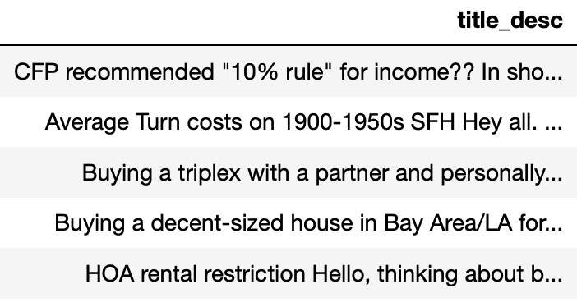
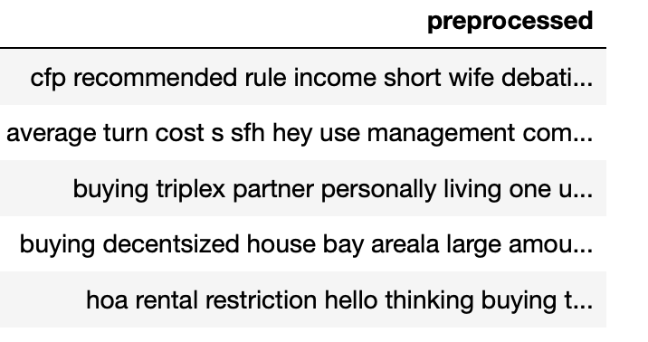
D A T A C L E A N I N G

Slide 13
EXPLORATORY DATA ANALYSIS

Slide 14
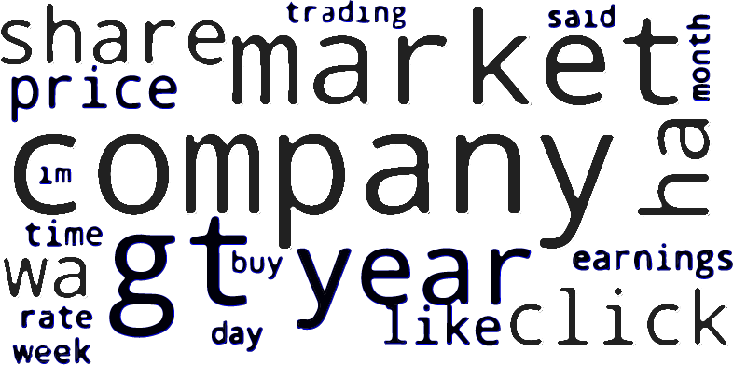
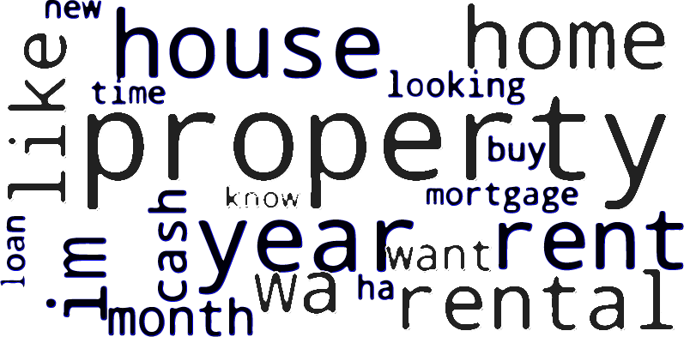
R/Stocks
R/Real Estate Investing
E D A ( W O R D C L O U D )

Slide 15
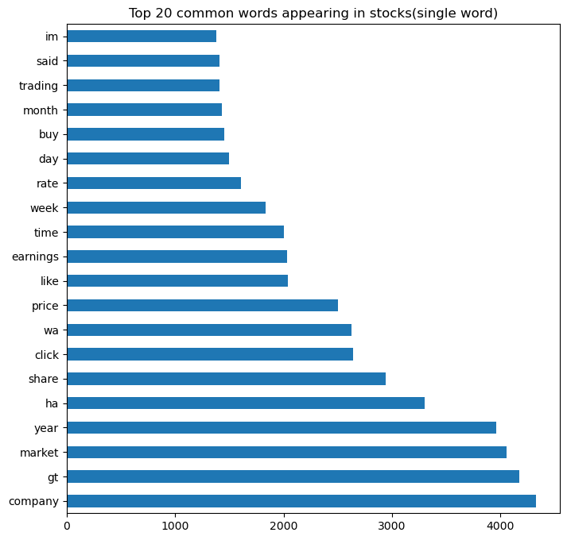
EDA (TOP 20 MOST COMMON WORD )
1.05 TIMES ‘COMPANY’ PER POST
1.02 TIMES ‘GT’ PER POST

Slide 16
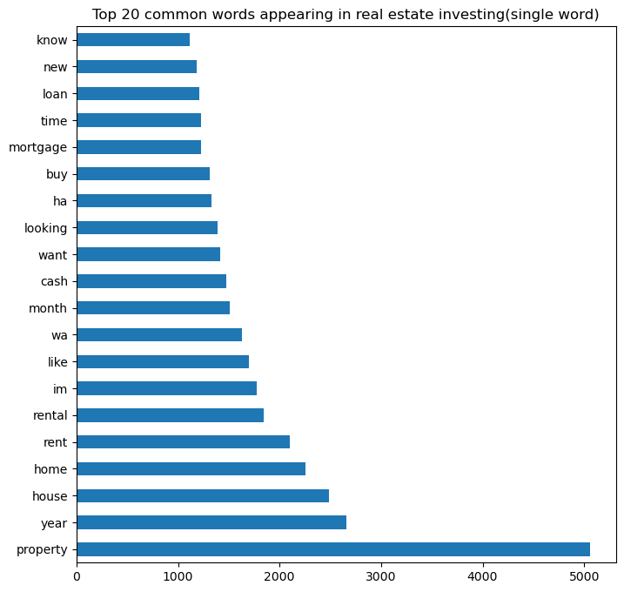
EDA (TOP 20 MOST COMMON WORD )
1.2 TIMES ‘PROPERTY’ PER POST
0.7 TIMES ‘YEAR’ PER POST

Slide 17
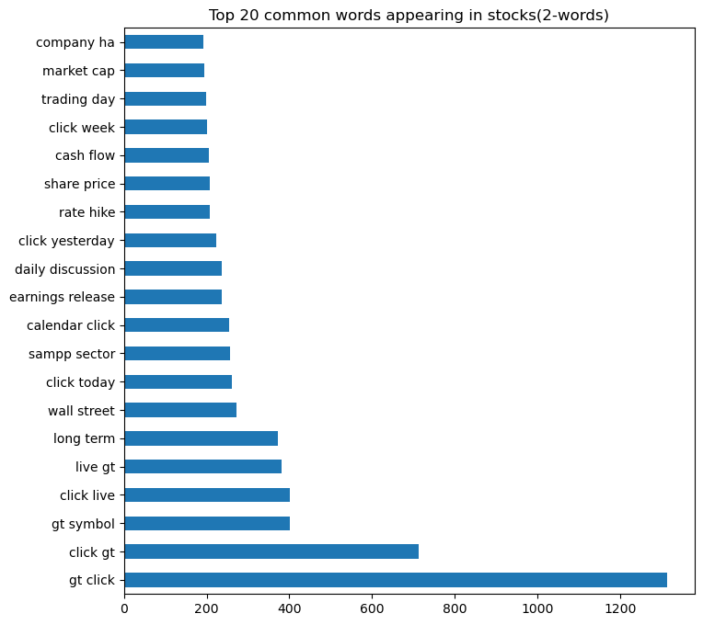
EDA (TOP 20 MOST COMMON WORD )
0.8 TIMES ‘GOT CLICK’ PER POST

Slide 18
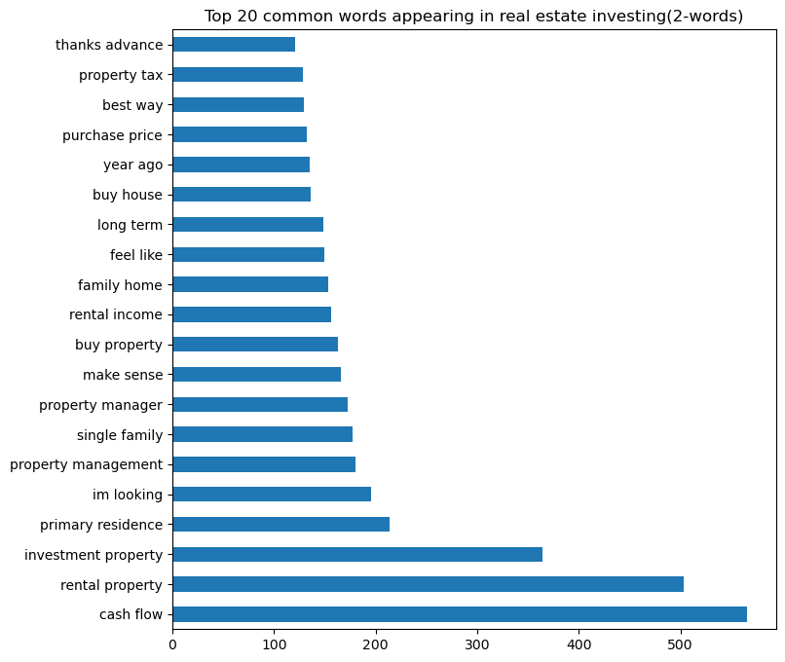
EDA (TOP 20 MOST COMMON WORD )
0.5 TIMES ‘CASH FLOW’ PER POST
0.12 TIMES ‘RENTAL PROPERTY’ PER POST

Slide 19
MODELLING AND RESULT

Slide 20
Multinomial Naive Bayes
Bernoulli
Naive Bayes
Model
Logistic Regression
Random Forest
T Y P E S O F M O D E L U S E D

Slide 21
Logistic Regression with TF-IDF vectorization selected
Optimized for accuracy
Model | Method | Train Score | Test Score | Precision(Stocks) | Precision(Real Estate)
Logistic Regression | BOW | 0.999 | 0.9622 | 0.96 | 0.96
Multinominal Naive Bayes | BOW | 0.9755 | 0.9464 | 0.97 | 0.93
Bernoulli Naive Bayes | BOW | 0.9415 | 0.8946 | 0.97 | 0.83
Random Forest | BOW | 0.9999 | 0.9651 | 0.95 | 0.98
Logistic Regression | TF-IDF | 0.9989 | 0.9662 | 0.96 | 0.98
Multinominal Naive Bayes | TF-IDF | 0.9836 | 0.9645 | 0.97 | 0.96
Bernoulli Naive Bayes | TF-IDF | 0.9852 | 0.9566 | 0.96 | 0.96
Random Forest | TF-IDF | 0.9999 | 0.9594 | 0.94 | 0.98
Logistic Regression | n-gram(2,2) | 0.9997 | 0.9211 | 0.90 | 0.95
Multinominal Naive Bayes | n-gram(2,2) | 0.9997 | 0.9278 | 0.94 | 0.91
Bernoulli Naive Bayes | n-gram(2,2) | 0.9927 | 0.9228 | 0.93 | 0.91
Modelling Result

Slide 22
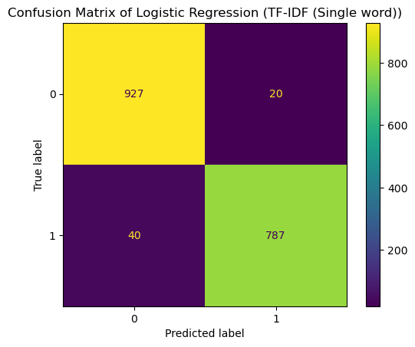
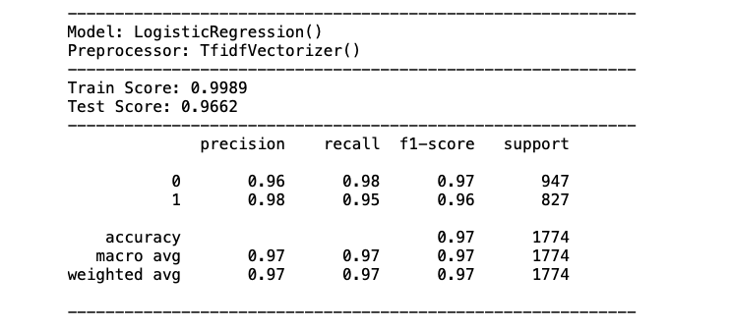
L O G I S T I C R E G R E S S I O N R E S U L T S
Logistic Regression is able to predict 97% accuracy
Training Set Score was at 0.9989
Test Set Score was at 0.9662
Both score are similar which could say there is no overfitting

Slide 23
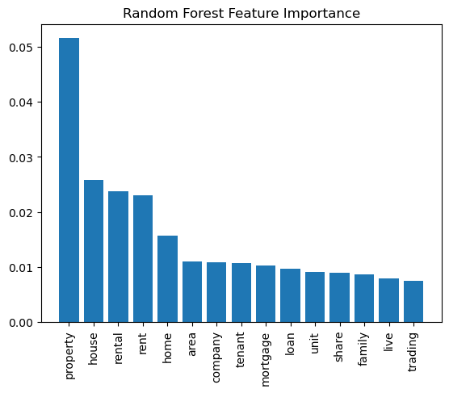
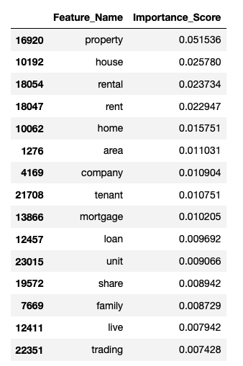
Random Forest Classifier

Slide 24

Summary
Logistic Regression showed the best model
Usage of Random Forest classifier as it is less prone to overfitting and achieve higher accuracy.
Lack of Data
  Using subreddit as source

Slide 25
Thank you

